Slide 1

MEDIA DISINFORMATION COUNTERSTRATEGY: CHALLENGES AND PROSPECTS
Х
Prof. TARAS HURZHII
State University of
Trade and Economics
Kyiv, Ukraine

Slide 2
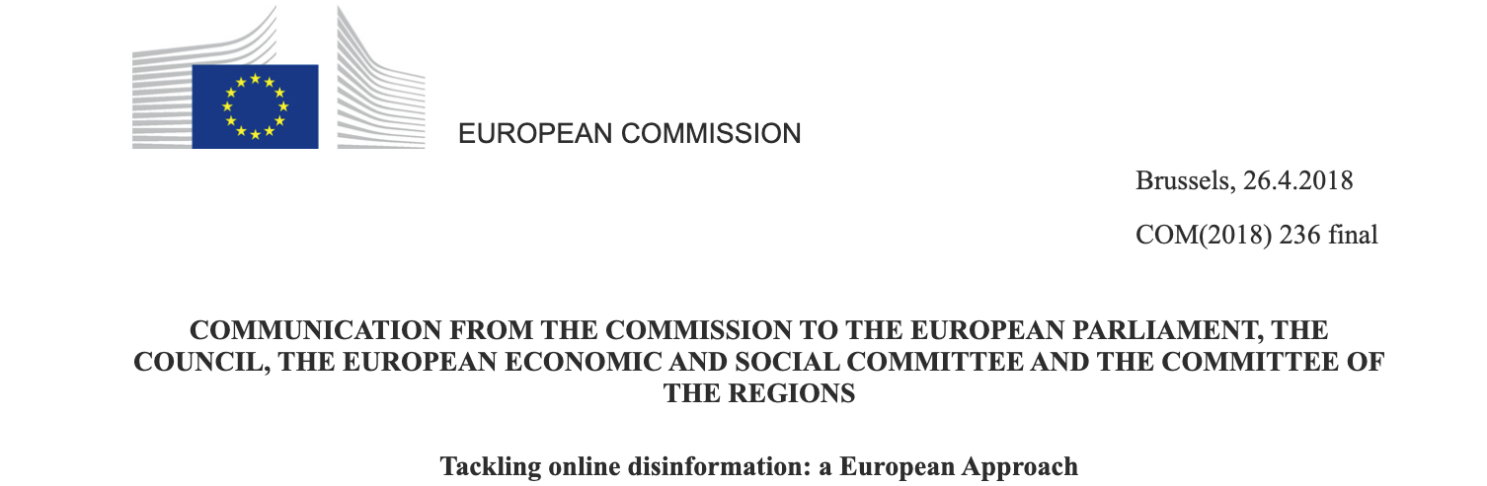
«DISINFORMATION is understood as verifiably false or misleading information that is created, presented and disseminated for economic gain or to intentionally deceive the public, and may cause public harm»

Slide 3
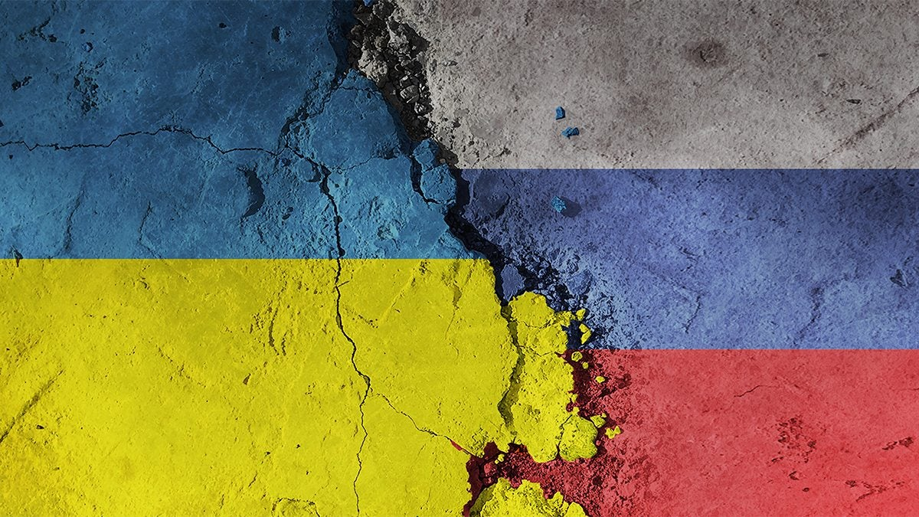

RUSSIAN DISINFORMATION
CAMPAIGNS
MAIN OBJECTIVES:
Promoting hostile narratives
Public discord
Manipulation by public opinion
Delegitimization of Ukraine’s government and democratic institutions
Weakening public trust in the media and civil society

Slide 4
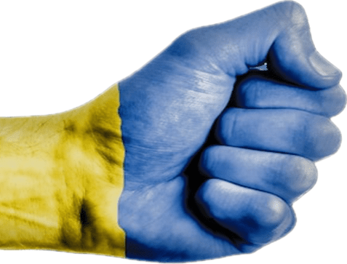
INFORMATION SECURITY STRATEGY
Implementation of early identification and prevention of disinformation
Strengthening responsibility for disseminating false information
Enhancing capabilities to conduct counter-disinformation operations

Slide 5
INFORMATION SECURITY STRATEGY
Improving media literacy and public awareness to reduce public vulnerability to disinformation
Expanding partnerships with international organizations, allies, and and civil society institutions

Slide 6


THE CENTER FOR COUNTERING DISINFORMATION
UNDER THE NATIONAL SECURITY AND DEFENSE COUNCIL
MAIN FUNCTIONS:
monitoring and analysis of events and materials in media space
identifying current and projected threats to information security and national interests
coordination of the development of a comprehensive system of strategic communications
creation of integrated system for responding to information threats
developing a methodology for identifying manipulative and disinformation materials in media
promoting interaction between the state and civil society institutions in countering disinformation

Slide 7
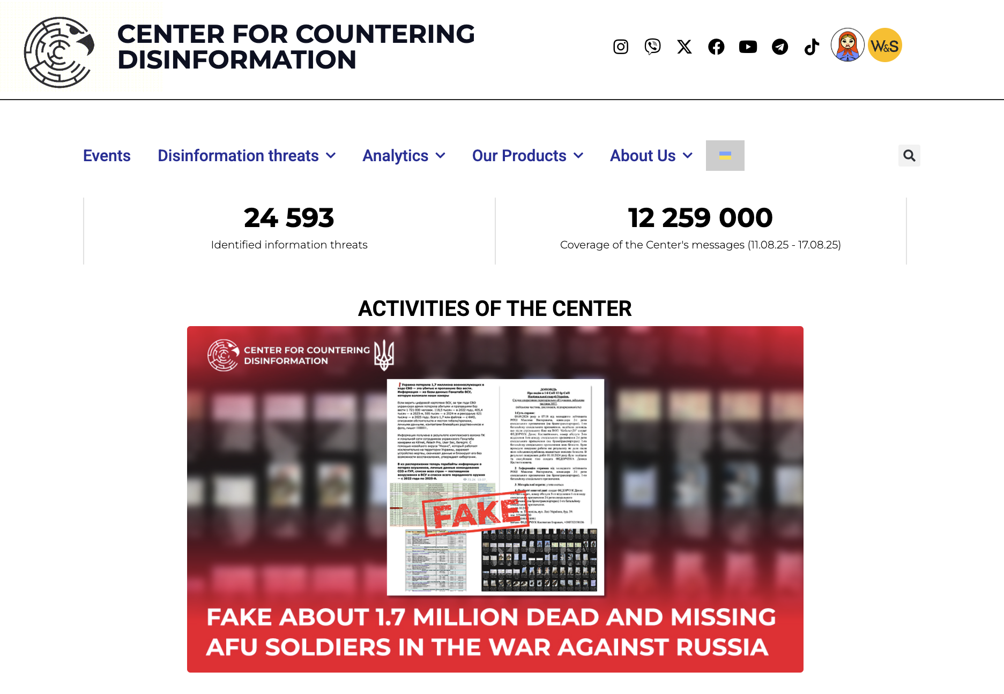
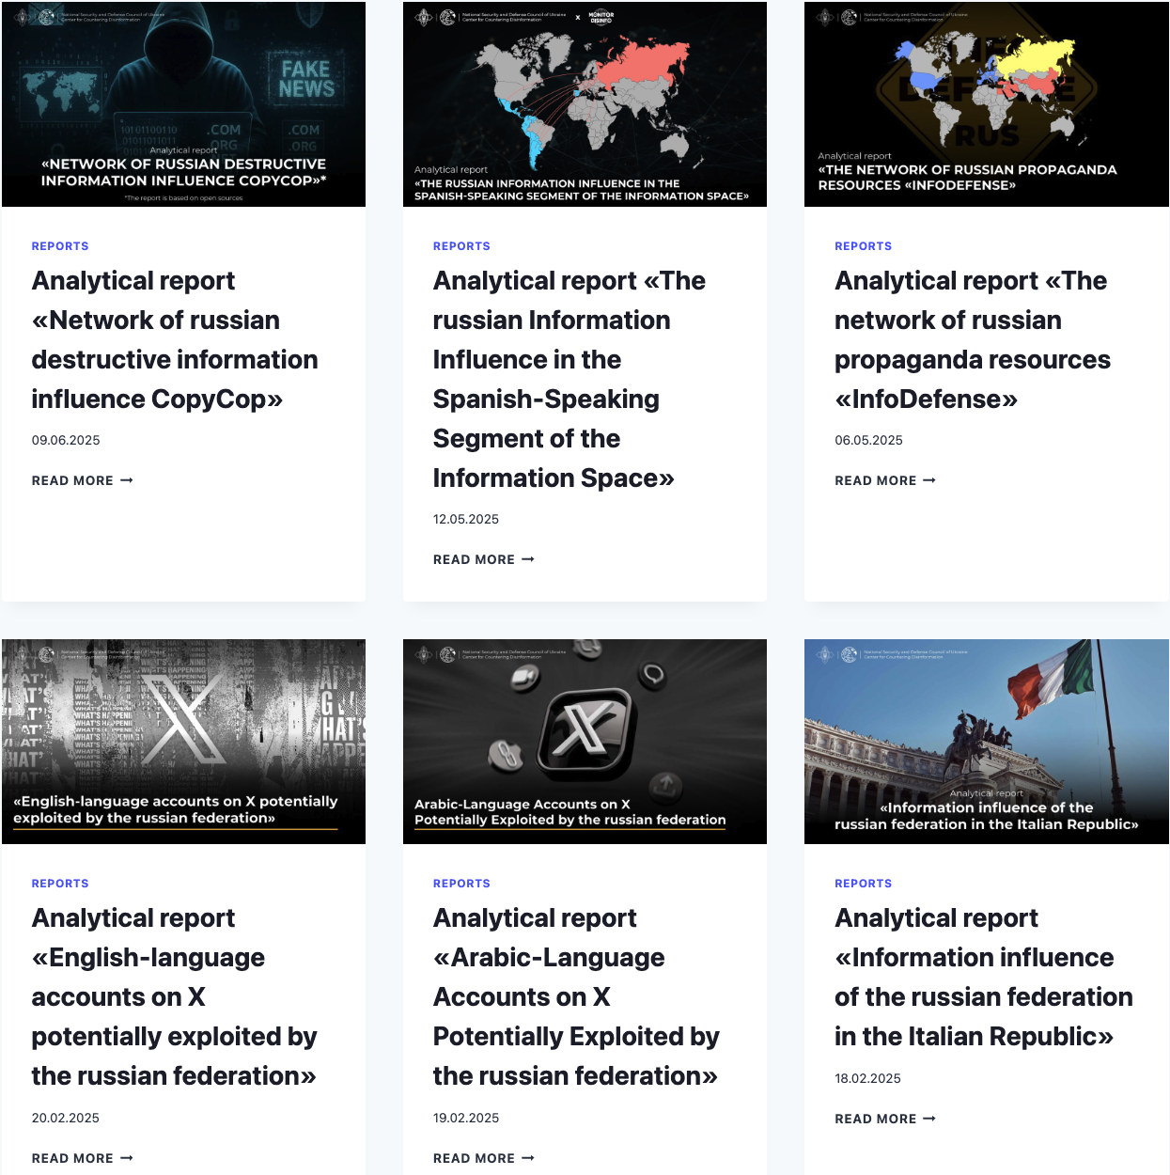

Slide 8
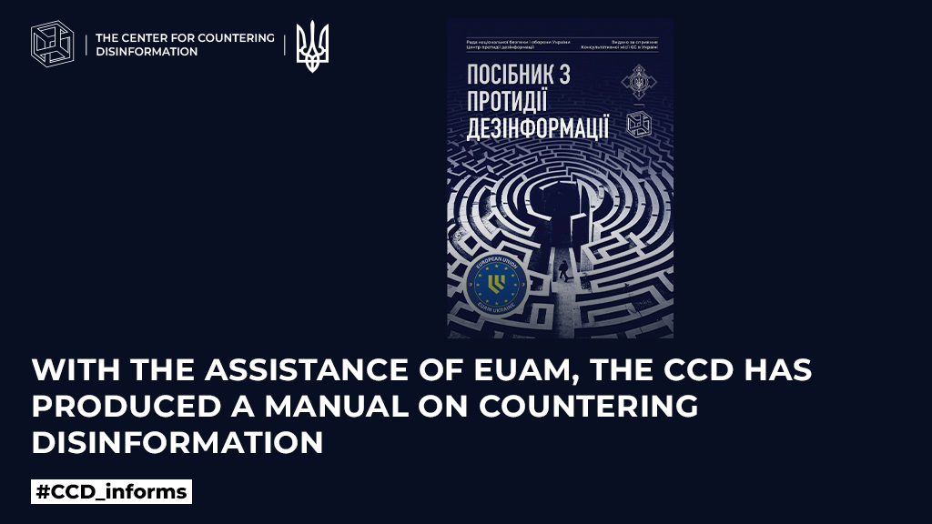

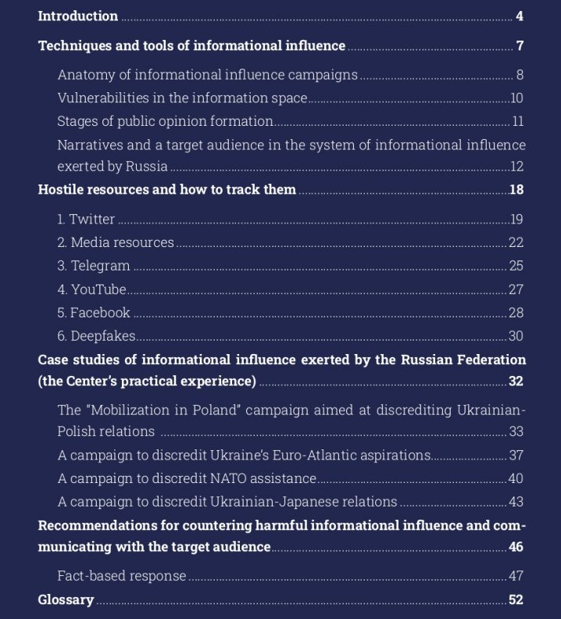


Slide 9
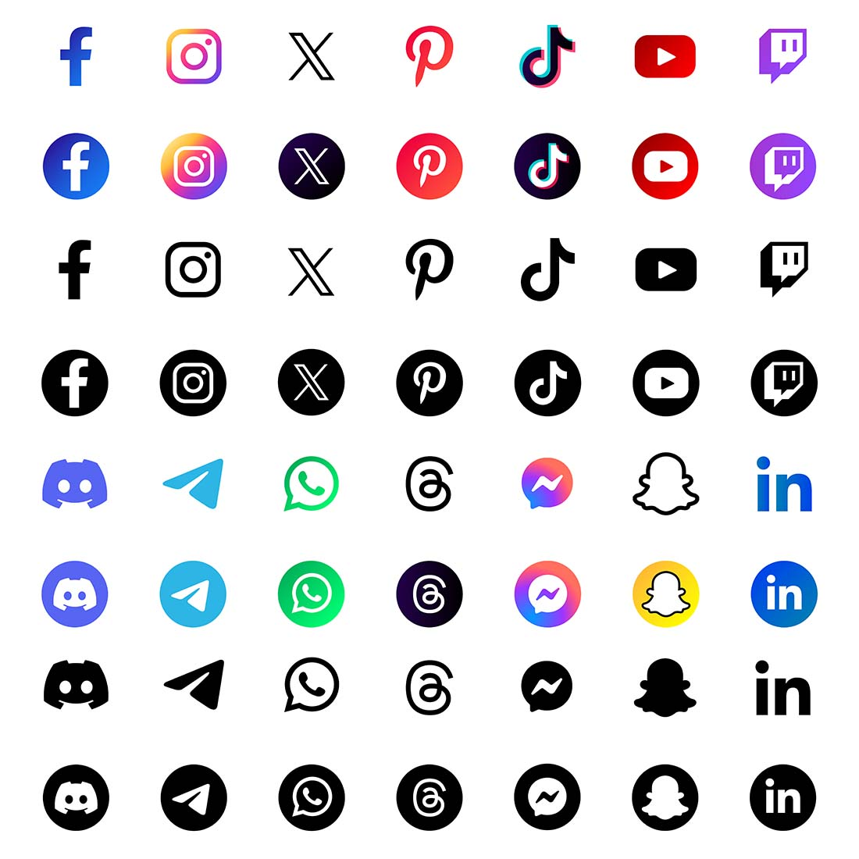
ACTIVITIES OF THE CENTER (COVERAGE):
150 TikTok channels
101 YouTube channels
280 Facebook accounts
449 Telegram channels
156 foreign internet resources
resources of 296 different organizations
812 speakers who disseminate
disinformation in Ukrainian, Russian, German
and English.

Slide 10

THE CENTER FOR COUNTERING DISINFORMATION
lack of administrative powers
insufficient coordination with other government bodies
limited resources
low transparency

Slide 11
Criminal Code of Ukraine: Art 436-2
…
…
Justification, recognition as lawful, denial of the armed aggression of the Russian Federation against Ukraine, glorification of its participants, committed with the use of mass media, -
shall be punished by imprisonment for a term of 5 to 8 years with or without confiscation of property.

Slide 12
Art. 436-2 Criminal Code of Ukraine:
practice of application (2022-2026)
2,500 cases opened
1,200 individuals formally charged
539 court verdicts have been issued
33 convictions specifically concerning offenses committed through mass media. These cases typically involve popular social media platforms such as Facebook, TikTok, Telegram, and others.

Slide 13
Art. 436-2 Criminal Code of Ukraine:
the issues of application (2022-2026)
collision with Art. 111-1 of Criminal Code “Collaborationism”, which criminalizes “public denial of the armed aggression against Ukraine by a Ukrainian citizen, including through the Internet or mass media”
some harmful disinformation forms are not covered
ineffective enforcement against anonymous or foreign-based actors
no clear distinction between accidental, mistaken, and intentional disinformation

Slide 14


Slide 15
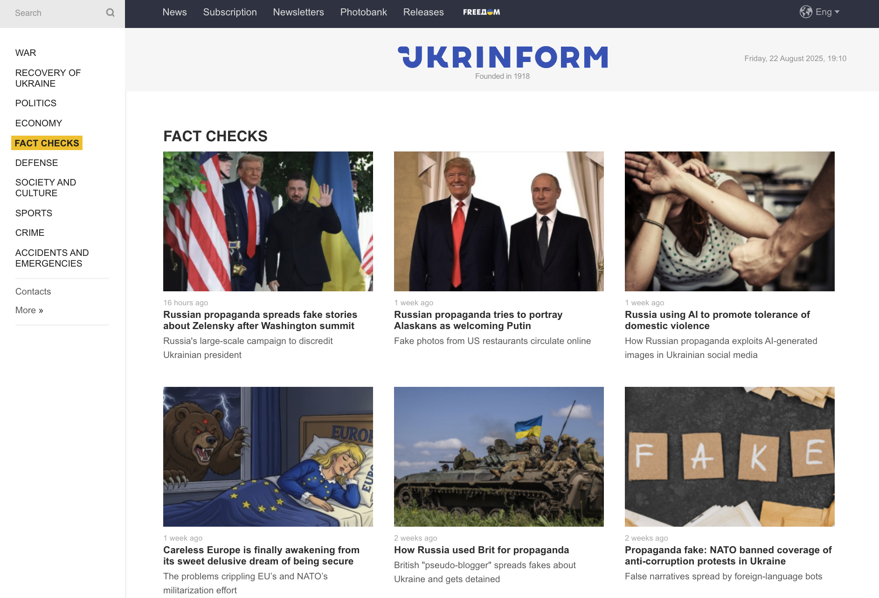

Slide 16

THE CENTER FOR COUNTERING DISINFORMATION
Between 2023-2026, a total of 950 fact-checks were published in Ukrainian and English
Every week the Center:
registers around 300 destructive informational messages
issues about 15 digests summarizing monitoring outcomes of key events
distributes 10 information response cards

Slide 17


THE SYSTEM FOR EARLY DETECTION, FORECASTING, AND PREVENTION OF HYBRID THREATS
based on manual monitoring
no coordination structure
slow implementation of AI and machine learning
no unified platform for real-time data collection and analysis
no effective links with the private sector

Slide 18

Modern challenges for countering disinformation
spreading disinformation by networks and messaging apps (reduced control over closed groups, Telegram channels, and private chats)
wide usage of anonymous, encrypted channels and networks
gamification and emotional manipulation in disinformation campaigns

Slide 19
Modern challenges for countering disinformation
wide usage of AI in generating fake informational content
accelerated growth and proliferation of deepfake technologies
generating of fake news by automated websites and aggregators
high personalization of disinformation

Slide 20

Key goals for Ukraine’s new Information Security Strategy
Improving the legal framework for media responsibility for spreading disinformation
Developing an integrated system for early detection, forecasting, and prevention of hybrid threats
Enhancing the effectiveness and transparency of the Center for Countering Disinformation

Slide 21
Key goals for Ukraine’s new Information Security Strategy
Promoting media literacy and information culture
Ensuring information security of critical infrastructure
Enhancing resource provision and specialist training

Slide 22

Thanks
for your time and interest

